Slide 1
Chapter 1 Introduction

Slide 2
What is a Derivative?
A derivative is an instrument whose value depends on, or is derived from, the value of another asset.
Examples: futures, forwards, swaps, options, exotics…

Slide 3
Why Derivatives Are Important
Derivatives play a key role in transferring risks in the economy
The underlying assets include stocks, currencies, interest rates, commodities, debt instruments, electricity, insurance payouts, the weather, etc
Many financial transactions have embedded derivatives
The real options approach to assessing capital investment decisions has become widely accepted

Slide 4
How Derivatives Are Traded
On exchanges such as the Chicago Board Options Exchange (CBOE)
In the over-the-counter (OTC) market where traders working for banks, fund managers and corporate treasurers contact each other directly

Slide 5
The OTC Market Prior to 2008
Largely unregulated
Banks acted as market makers quoting bids and offers
Master agreements usually defined how transactions between two parties would be handled
But some transactions were handled by central counterparties (CCPs). A CCP stands between the two sides to a transaction in the same way that an exchange does

Slide 6
Since 2008…
OTC market has become regulated. Objectives:
Reduce systemic risk (see Business Snapshot 1.2, page 5)
Increase transparency
In the U.S and some other countries, standardized OTC products must be traded on swap execution facilities (SEFs) which are similar to exchanges
CCPs must be used for standardized transactions between dealers in most countries
All trades must be reported to a central registry

Slide 7
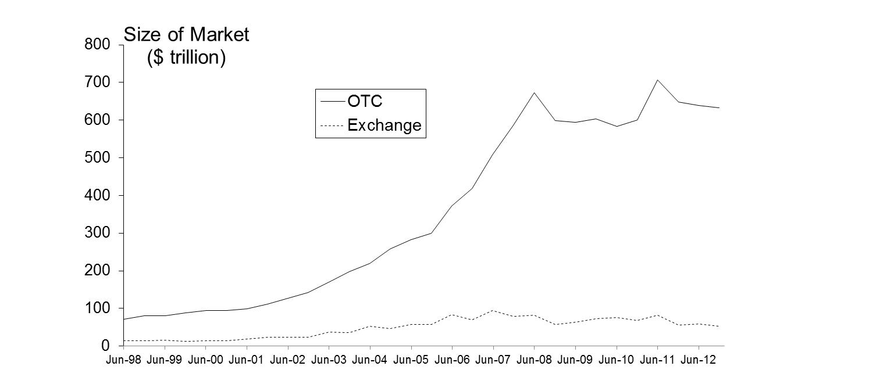
Size of OTC and Exchange-Traded Markets (Figure 1.1, Page 5)
Source: Bank for International Settlements. Chart shows total principal amounts for OTC market and value of underlying assets for exchange market

Slide 8
The Lehman Bankruptcy (Business Snapshot 1.1)
Lehman’s filed for bankruptcy on September 15, 2008. This was the biggest bankruptcy in US history
Lehman was an active participant in the OTC derivatives markets and got into financial difficulties because it took high risks and found it was unable to roll over its short term funding
It had hundreds of thousands of transactions outstanding with about 8,000 counterparties
Unwinding these transactions has been challenging for both the Lehman liquidators and their counterparties

Slide 9
How Derivatives are Used
To hedge risks
To speculate (take a view on the future direction of the market)
To lock in an arbitrage profit
To change the nature of a liability
To change the nature of an investment without incurring the costs of selling one portfolio and buying another
Notes:
4

Slide 10
Foreign Exchange Quotes for GBP, May 26, 2013 (See page 6)
 | Bid | Offer
Spot | 1.5541 | 1.5545
1-month forward | 1.5538 | 1.5543
3-month forward | 1.5533 | 1.5538
6-month forward | 1.5526 | 1.5532

Slide 11
Forward Price
The forward price for a contract is the delivery price that would be applicable to the contract if were negotiated today (i.e., it is the delivery price that would make the contract worth exactly zero)
The forward price may be different for contracts of different maturities (as shown by the table)
Notes:
11

Slide 12
Terminology
The party that has agreed to buy has what is termed a long position
The party that has agreed to sell has what is termed a short position
Notes:
10

Slide 13
Example (page 6)
On May 6, 2013, the treasurer of a corporation enters into a long forward contract to buy £1 million in six months at an exchange rate of 1.5532
This obligates the corporation to pay $1,553,200 for £1 million on November 6, 2013
What are the possible outcomes?

Slide 14
Profit from a Long Forward Position (K= delivery price=forward price at time contract is entered into)
Profit
Price of Underlying at Maturity, S_{T}
K
Notes:
14

Slide 15
Profit from a Short Forward Position (K= delivery price=forward price at time contract is entered into)
Profit
Price of Underlying
at Maturity, S_{T}
K
Notes:
15

Slide 16
Futures Contracts (page 8)
Agreement to buy or sell an asset for a certain price at a certain time
Similar to forward contract
Whereas a forward contract is traded OTC, a futures contract is traded on an exchange

Slide 17
Exchanges Trading Futures
CME Group (formed when Chicago Mercantile Exchange and Chicago Board of Trade merged)
NYSE Euronext (being acquired by bteh InterContinental Exchange)
BM&F (Sao Paulo, Brazil)
TIFFE (Tokyo)
and many more (see list at end of book)

Slide 18
Examples of Futures Contracts
Agreement to:
Buy 100 oz. of gold @ US$1400/oz. in December
Sell £62,500 @ 1.5500 US$/£ in March
Sell 1,000 bbl. of oil @ US$90/bbl. in April
Notes:
9

Slide 19
1. Gold: An Arbitrage Opportunity?
Suppose that:
The spot price of gold is US$1,400
The 1-year forward price of gold is US$1,500
The 1-year US$ interest rate is 5% per annum
Is there an arbitrage opportunity?
Notes:
18

Slide 20
2. Gold: Another Arbitrage Opportunity?
Suppose that:
The spot price of gold is US$1,400
The 1-year forward price of gold is US$1,400
The 1-year US$ interest rate is 5% per annum
Is there an arbitrage opportunity?
Notes:
19

Slide 21
The Forward Price of Gold (ignores the gold lease rate)
If the spot price of gold is S and the forward price for a contract deliverable in T years is F, then
F = S (1+r )^{T}
where r is the 1-year (domestic currency) risk-free rate of interest.
In our examples, S = 1400, T = 1, and r =0.05 so that
F = 1400(1+0.05) = 1470
Notes:
20

Slide 22
1. Oil: An Arbitrage Opportunity?
Suppose that:
The spot price of oil is US$95
The quoted 1-year futures price of oil is US$125
The 1-year US$ interest rate is 5% per annum
The storage costs of oil are 2% per annum
Is there an arbitrage opportunity?
Notes:
21

Slide 23
2. Oil: Another Arbitrage Opportunity?
Suppose that:
The spot price of oil is US$95
The quoted 1-year futures price of oil is US$80
The 1-year US$ interest rate is 5% per annum
The storage costs of oil are 2% per annum
Is there an arbitrage opportunity?
Notes:
22

Slide 24
Options
A call option is an option to buy a certain asset by a certain date for a certain price (the strike price)
A put option is an option to sell a certain asset by a certain date for a certain price (the strike price)

Slide 25
American vs European Options
An American option can be exercised at any time during its life
A European option can be exercised only at maturity

Slide 26
Google Call Option Prices from CBOE (May 8, 2013; Stock Price is bid 871.23, offer 871.37); See Table 1.2 page 9
Strike Price | Jun 2013 Bid | Jun 2013 Offer | Sep 2013 Bid | Sep 2013 Offer | Dec 2013 Bid | Dec 2013 Offer
820 | 56.00 | 57.50 | 76.00 | 77.80 | 88.00 | 90.30
840 | 39.50 | 40.70 | 62.90 | 63.90 | 75.70 | 78.00
860 | 25.70 | 26.50 | 51.20 | 52.30 | 65.10 | 66.40
880 | 15.00 | 15.60 | 41.00 | 41.60 | 55.00 | 56.30
900 | 7.90 | 8.40 | 32.10 | 32.80 | 45.90 | 47.20
920 | n.a. | n.a. | 24.80 | 25.60 | 37.90 | 39.40

Slide 27
Google Put Option Prices from CBOE (May 8, 2013; Stock Price is bid 871.23, offer 871.37); See Table 1.3 page 9
Strike Price | Jun 2013 Bid | Jun 2013 Offer | Sep 2013 Bid | Sep 2013 Offer | Dec 2013 Bid | Dec 2013 Offer
820 | 5.00 | 5.50 | 24.20 | 24.90 | 36.20 | 37.50
840 | 8.40 | 8.90 | 31.00 | 31.80 | 43.90 | 45.10
860 | 14.30 | 14.80 | 39.20 | 40.10 | 52.60 | 53.90
880 | 23.40 | 24.40 | 48.80 | 49.80 | 62.40 | 63.70
900 | 36.20 | 37.30 | 59.20 | 60.90 | 73.40 | 75.00
920 | n.a. | n.a. | 71.60 | 73.50 | 85.50 | 87.40

Slide 28
Options vs Futures/Forwards
A futures/forward contract gives the holder the obligation to buy or sell at a certain price
An option gives the holder the right to buy or sell at a certain price

Slide 29
Types of Traders
Hedgers
Speculators
Arbitrageurs
Notes:
15

Slide 30
Hedging Examples (pages 11-13)
A US company will pay £10 million for imports from Britain in 3 months and decides to hedge using a long position in a forward contract
An investor owns 1,000 Microsoft shares currently worth $28 per share. A two-month put with a strike price of $27.50 costs $1. The investor decides to hedge by buying 10 contracts
Notes:
16

Slide 31
Value of Microsoft Shares with and without Hedging (Fig 1.4, page 13)

Slide 32
Speculation Example
An investor with $2,000 to invest feels that a stock price will increase over the next 2 months. The current stock price is $20 and the price of a 2-month call option with a strike of 22.50 is $1
What are the alternative strategies?
Notes:
17

Slide 33
Arbitrage Example
A stock price is quoted as £100 in London and $150 in New York
The current exchange rate is 1.5300
What is the arbitrage opportunity?

Slide 34
Dangers
Traders can switch from being hedgers to speculators or from being arbitrageurs to speculators
It is important to set up controls to ensure that trades are using derivatives in for their intended purpose
Soc Gen (see Business Snapshot 1.4 on page 18) is an example of what can go wrong

Slide 35
Hedge Funds (see Business Snapshot 1.3, page 12)
Hedge funds are not subject to the same rules as mutual funds and cannot offer their securities publicly.
Mutual funds must
disclose investment policies,
makes shares redeemable at any time,
limit use of leverage
Hedge funds are not subject to these constraints.
Hedge funds use complex trading strategies are big users of derivatives for hedging, speculation and arbitrage

Slide 36
Types of Hedge Funds
Long/Short Equities
Convertible Arbitrage
Distressed Securities
Emerging Markets
Global Macro
Merger Arbitrage

